Slide 1

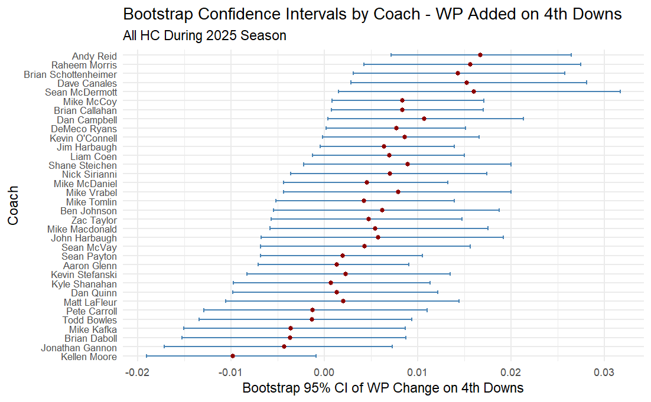
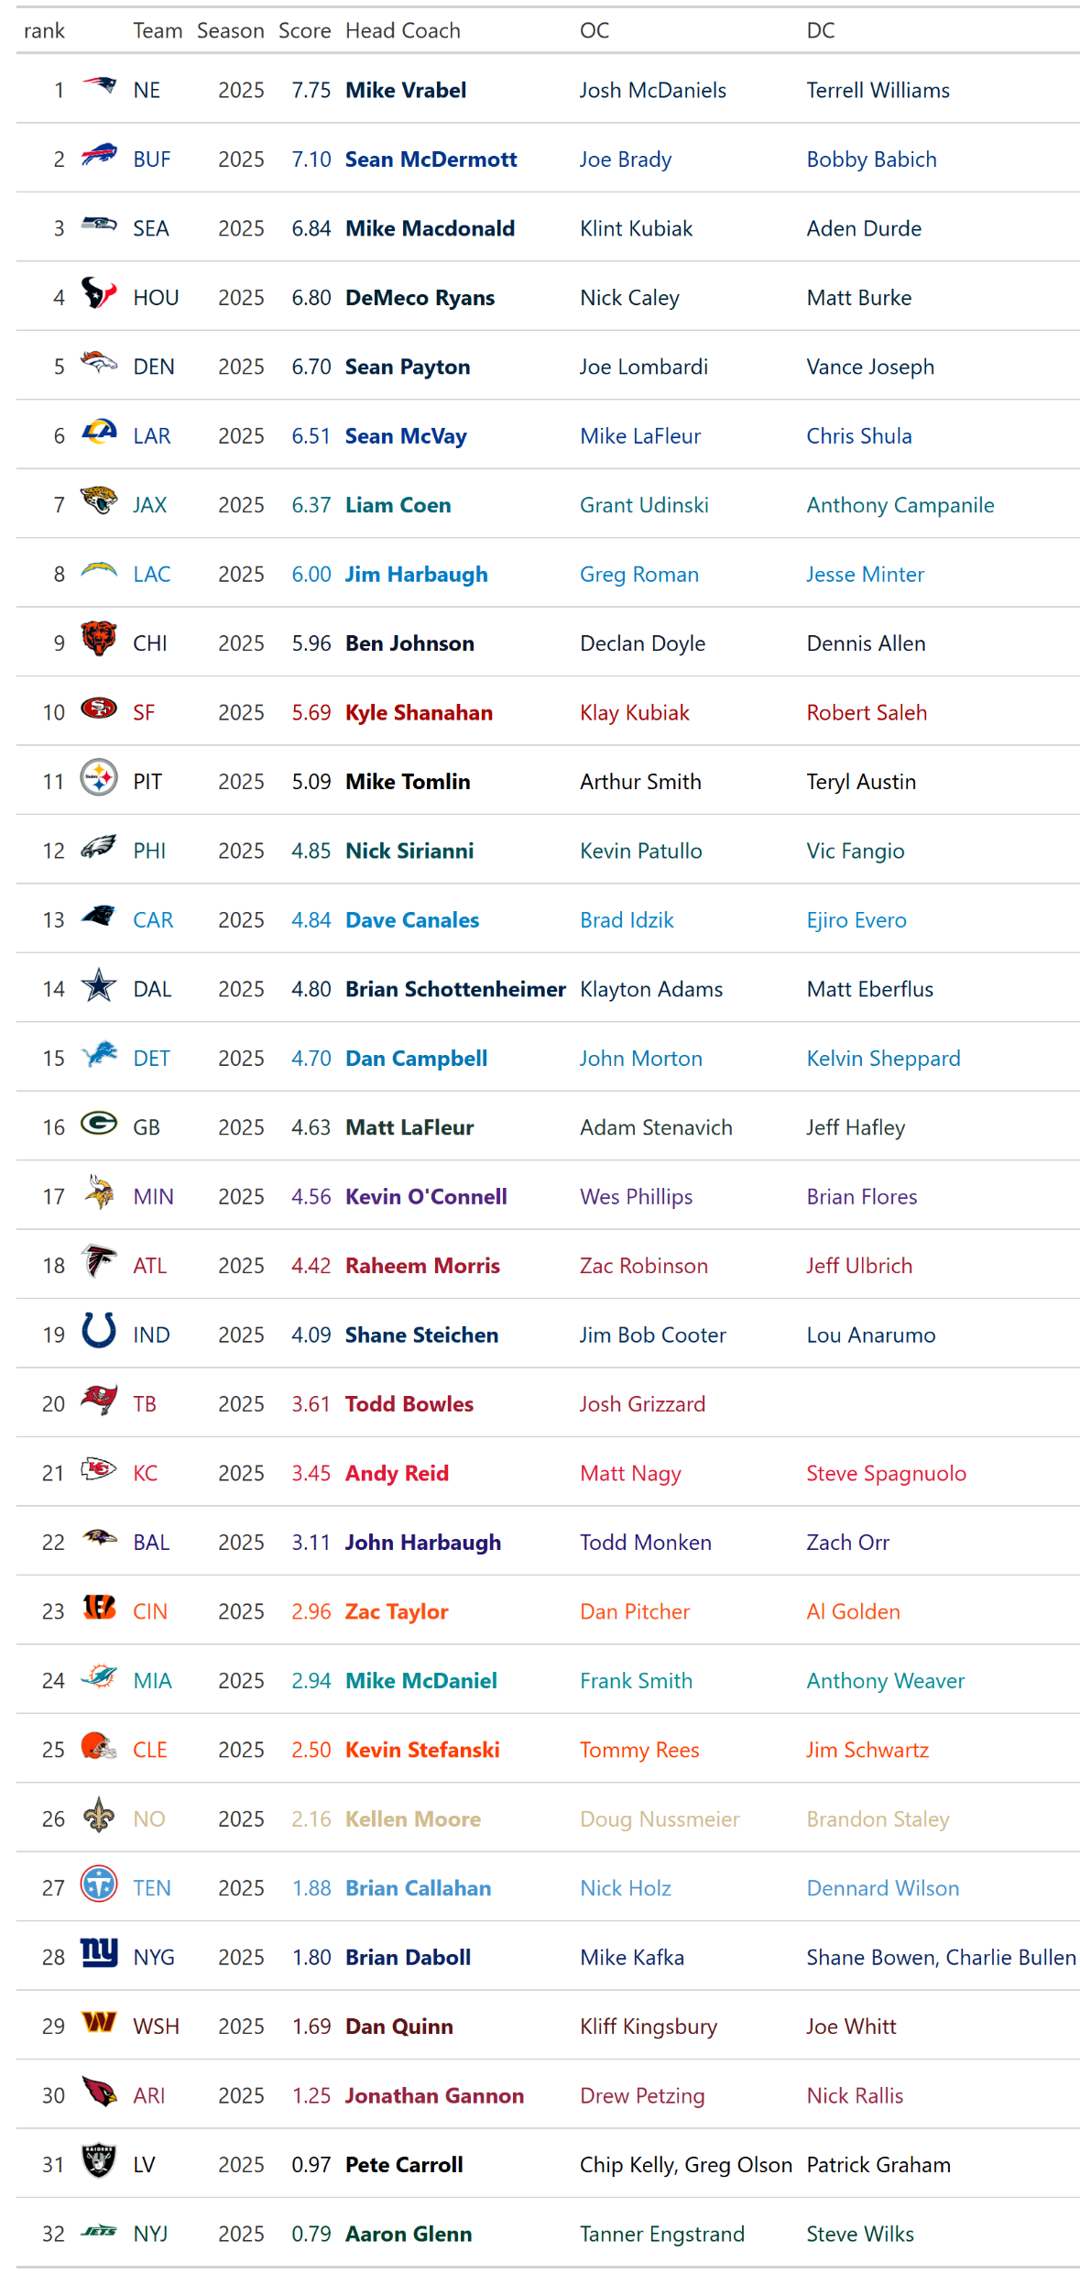
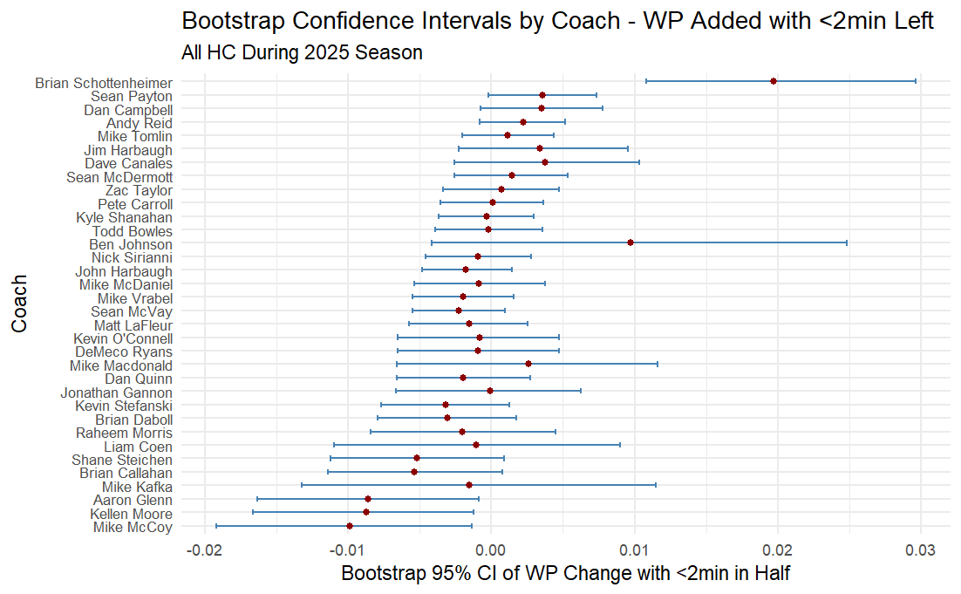

Coaching Value in the NFL
Will Kinnebrew ‘27
Department of Sport Management, School of Social Sciences, Rice University
abstract
methods
Results – This season
While coaching is a primary driver of success in the NFL, a standard quantitative metric to measure a coach’s literal value to their team remains elusive. This research introduces a data-driven framework to quantify coaching value by analyzing play-by-play data since 2017.
Coaches are evaluated through a cumulative score derived from several independent performance categories, including decision-making in high-leverage situations (fourth downs, close games, and "crunch time") and raw success (regular season, divisional, and playoff records).
A key innovation of the model is the isolation of player development using a Hierarchical Bayesian Adjusted Plus-Minus (APM) model based on Expected Points Added (EPA). By comparing observed player impact against expectations based on age, experience, volume, and draft position, systemic roster overperformance is identified and attributed to coaching quality.
The framework also offers practical utility by identifying high-performing current coaches like Mike Vrabel and targeting valuable assistant candidates for future hiring cycles.
Furthermore, the model highlights discrepancies between coaching value and job security, as seen in the firing of Sean McDermott despite a strong score in 2025 and the second highest total score since 2017.
Ultimately, this research provides NFL organizations with a robust tool to move beyond traditional narratives and objectively identify elite coaching talent.
For close games, fourth downs, and crunch time scenarios, value is derived as the percentile ranking of the coach’s total win probability over expected added on plays in those situations. In order to compare coaches on their true quality in these categories, we can bootstrap the observations to create confidence intervals that estimate the true mean value they add in these scenarios. This is done for 4th down playcalling and two-minute drill playcalling, as shown on the right.
For raw success, we can take the coach’s percentile rankings on total regular season wins, divisional wins, and playoff success relative to other coaches that season. Playoff success is defined as the round reached, where there are essentially 6 levels a team can be at (Super Bowl winner, loser, championship loser, divisional round loser, wildcard loser, and missing playoffs entirely).
Each of these contribute 1 point to the coach’s final cumulative score.
Top & Bottom Coaches from 2025 Season
Introduction
“Good Players Can’t Overcome Bad Coaching” –Bill Belichick
NFL Coaches set the floor and ceiling for their teams. More than any other professional sport, NFL coaches are highly responsible for game decisions, playcalling, and putting their team in the best position to win games. They add or subtract value in the form of points and wins every single play, yet there exists no metric to quantify this.
According to research conducted by Goff Brian (2013), NFL coaches alone account for up to a 15% increase in wins and a 12% increase in losses, accounting for up to 21% of total variation in wins. That number is only 8.5% in the MLB.
Arguably the most important part of a coach’s job is their ability to maximize the talent they possess. The player development metric quantifies a coach’s specific ability to make players overperform their expected value.
This analysis utilizes a Hierarchical Bayesian Adjusted Plus-Minus (APM) model, where the outcome of every play is measured using Expected Points Added (EPA).
By treating each play as an observation of 22 simultaneous players, the model estimates an individual’s true impact while isolating it from teammate-related and opponent-related noise. The Bayesian framework is essential because it applies "shrinkage" to handle backups with limited data, ensuring their scores are not over-evaluated compared to high-snap starters.
Player development is formally defined as the deviation between Observed APM and Expected APM, with the latter predicted via a regression of prior performance, age, experience, volume, and draft position. When a roster exhibits systemic overperformance, the model attributes this success to high coaching quality.
This approach separates talent into offense and defense, and attributes both a defensive development and offensive development score to coaches (one point each) as well as a total score (one point). Combined with the 6 prior points, we have a 9-point scale for coaches.
In the most recent 2025 NFL Season, three of the championship-contending head coaches were in their first three seasons with their new team. Mike Vrabel (Patriots) is in hist first year with the club, ultimately contending for a Super Bowl. Sean Paytin (Broncos) is in year 3, contending for an AFC Championship. Mike Macdonald (Seahawks) is in year 2 and won the Super Bowl in his first ever stint as a head coach. Sean McVay (Rams) is in his 9th year with the club, but is still the fourth youngest coach in the league.
10 NFL Teams had a Head Coaching vacancy after the 2025 season.
The Bills, Cardinals, Falcons, Ravens, Browns, Raiders, Dolphins, Giants, Steelers, and Titans all were looking for the best option to lead their team in a new direction.
So how do coaches add value?
In a lot of ways. This study will derive their scores from several independent performance categories, such as decision-making in high-leverage situations (two-minute, fourth downs, close games), raw success (regular season, divisional games, playoffs), and player development. For some of these categories, value is added through win percentage over expected, and for others value is added through points added over expected. In order to make a standardized score for all coaches, their scores will reflect their ability to add value relative to other coaches that season, as opposed to being a raw reflection of total value added, since there is no clear way to translate points to wins and vice versa.
Results – This Hiring Cycle
HC Hired This Cycle:
Bills – Joe Brady (2.53*)
Cardinals – Mike LaFleur (2.12*)
Falcons – Kevin Stefanski (3.46)
Ravens – Jesse Minter (2.95*)
Browns – Todd Monken (2.011*)
Raiders – Klint Kubiak (2.28*)
Dolphins – Jeff Hafley (2.5*)
Giants – John Harbaugh (5.31)
Steelers – Mike McCarthy (4.94)
Titans – Robert Saleh (2.14)
*only ever an asst coach, so score is roughly out of 4.5
Other Prominent Candidates:
Sean McDermott (5.96)
Doug Pederson (4.59)
Pete Carroll (4.45)
Mike McDaniel (4.29)
Mike Zimmer (4.24)
Eric Bieniemy; 3.14
Greg Roman; 2.9
Pete Carmichael; 2.78
George Edwards; 2.8
Joe Lombardi; 2.51
conclusions
By using various EPA and Win Probability metrics, we can attribute these residuals to coaches to give an estimate of the literal value they add in the form of points and wins to their teams. This information can then be used to not only identify top performing current coaches, but also up and coming assistant coaches that should be targets during a hiring cycle. On their own, these metrics can indicate poor or positive performance from coaches, but when combined can provide a much larger picture about which coaches consistently add value across the board, or could be analyzed further to see specific areas a coach excels or needs to improve.
Notes:
You can rearrange each section (e.g., Abstract, Introduction, etc.) or customize as needed to best fit your content. This is just a sample layout of the poster.

